Slide 1
Fundamental steps of research design: What awaits new students?
Bilge Karabacak, Ph.D.| Lead Faculty, Cybersecurity
6/24/2022
RESEARCH REIMAGINED | Second Annual Doctoral Student Association Conference | June 24 - 25, 2022

Slide 2
My Ph.D. journey
My 1st Ph.D. attempt: 2003-2009
My 2nd Ph.D. attempt: 2009-2015
5 steps of research design
Image source: https://www.iamg-us.com

Slide 3
Context of the presentation
Research Design (The context of this presentation)
Research Proposal
Doctoral Research
Oral Defense
5 steps of research design
Start of the coursework
Comprehensive exam
2-3 years

Slide 4
Step 1 of 5: Identify a field of research
Accounting
Blockchain
This intersection is your research field.
This small circle will be your research topic.

Slide 5
Step 2 of 5: Make a literature review
Academic literature
Academic literature
Dissertations
Gray literature
White papers
Image source: https://bookriot.com/tree-bookshelves

Slide 6
Step 3 of 5: Confirm the availability of data
Research Data
Research Method
Image source: https://www.flaticon.com

Slide 7
Step 4 of 5: Identify your research method
Image source: https://iconscout.com

Slide 8
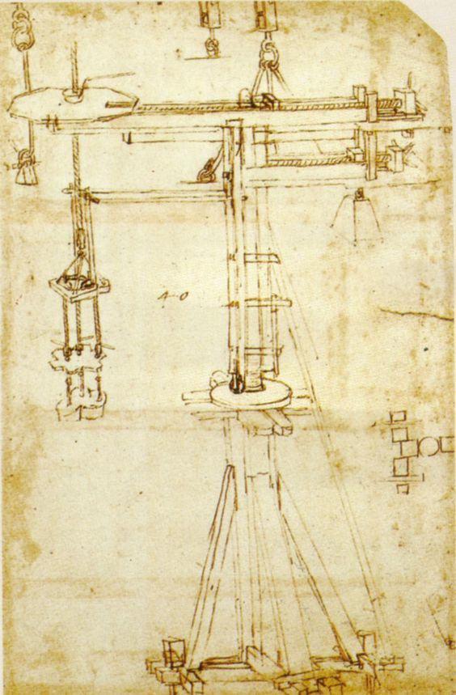
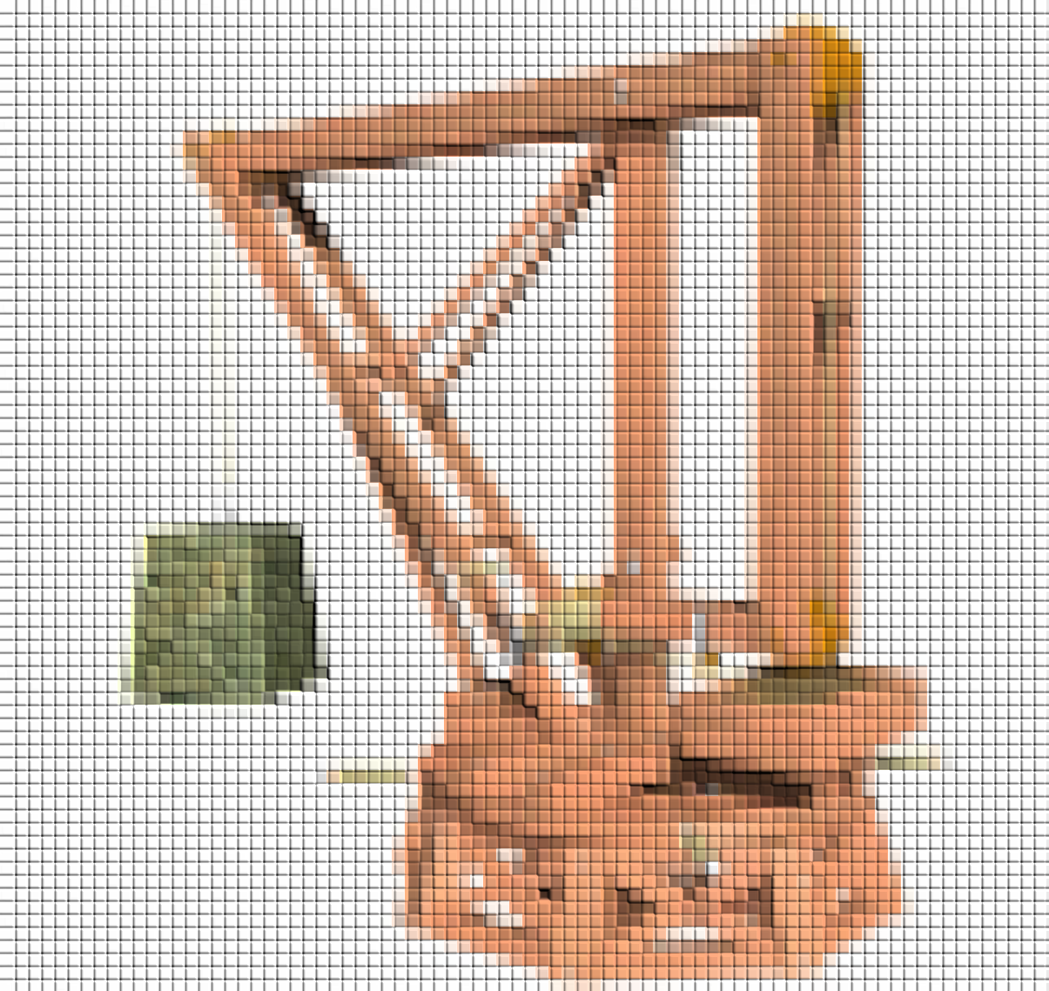
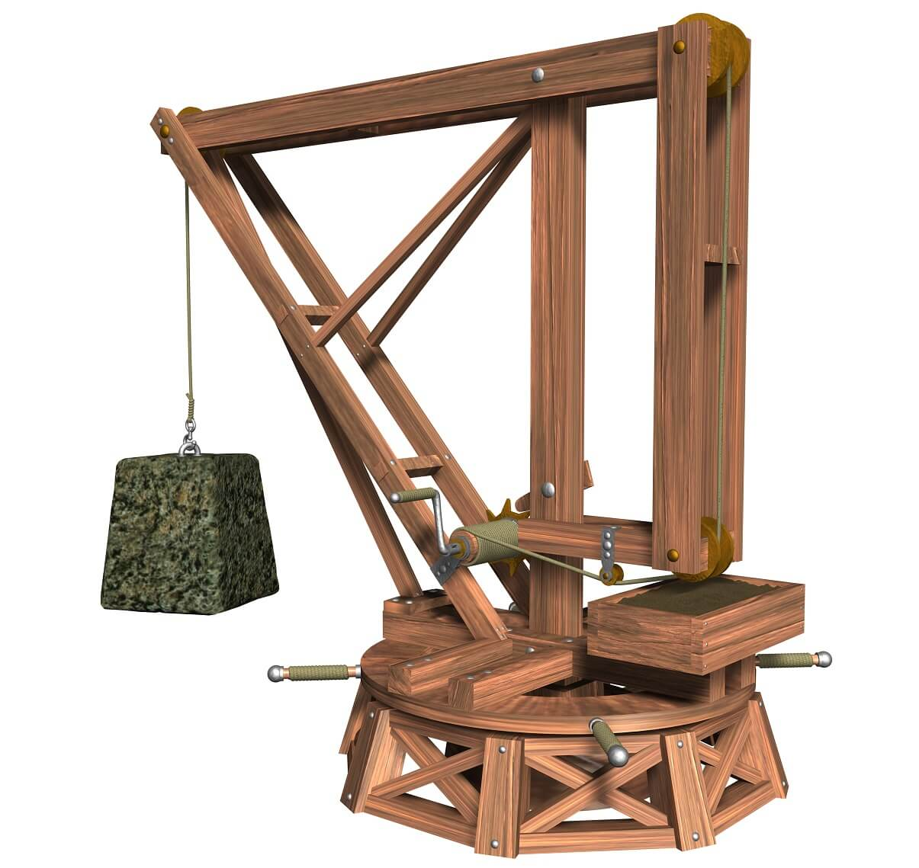
Step 5 of 5: Draft your research design
Leonardo Da Vinci, Grúa giratoria, Jib Crane
Start of the Coursework
Comprehensive Exam
Approval of the Proposal
Oral Defense
Draft Research Design
Research Proposal
Dissertation
Image source: https://www.pinterest.com/pin/313633561534981577
https://www.lifeder.com/inventos-leonardo-da-vinci

Slide 9
Summary
2-3 years
Step-1
Step-2
Step-3 & 4
Step-5
Start of the Coursework
Comprehensive Exam
Research Design
Research Proposal
Doctoral Research
Oral Defense
Image source: https://www.vecteezy.com

Slide 10
For questions and comments
Create an account on Lucid.app
Open the chart:
https://lucid.app/lucidchart/da52fa2a-e3cc-43b7-82f6-e1df8394228f/edit?invitationId=inv_afda9936-4a51-4427-a4a5-565ff8c9d437#
Put your questions and comments on chart!

Slide 11
Contact Information
Bilge Karabacak, Lead Faculty, Cybersecurity
Department of Computing Sciences and Mathematics
bilge.karabacak@franklin.edu
Book an appointment: https://outlook.office365.com/owa/calendar/BilgeKarabacak@FranklinU.onmicrosoft.com/bookings/

