Slide 1
Women in Educational Leadership:
Kindergarten through Higher Education
Dr. Rachel Althof | EdD Chair
Mrs. Katie Morgan | Asst. Principal-MEVSD

Slide 2
Understanding the Problem
K-12 Education
Female dominated (74%)
Balance in principalship
Central office gender gaps
Superintendent Position

Slide 3
Theme 1: Entry Points
Fewer entry points to superintendency
Elementary experience
Building principal experience
This Photo by Unknown Author is licensed under CC BY

Slide 4
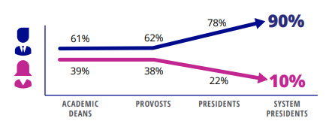
Leadership in Higher Education: Entry Points
(Silbert, A., et al., 2022)

Slide 5
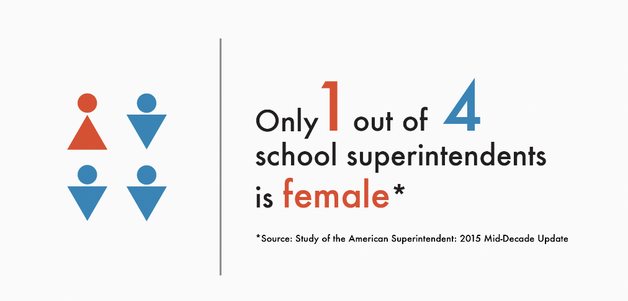
Theme 2: Credentials
Women do not obtain superintendent licensure at same rate as men
More female teachers
Female superintendents tend to amass more classroom years
Other specialized licensure pursuits
INSERT DATA VIS HERE

Slide 6
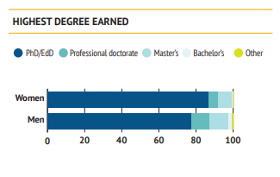
Leadership in Higher Education: Credentials
Characteristics of Presidents by Gender
(Howard & Gagliardi, 2018)

Slide 7
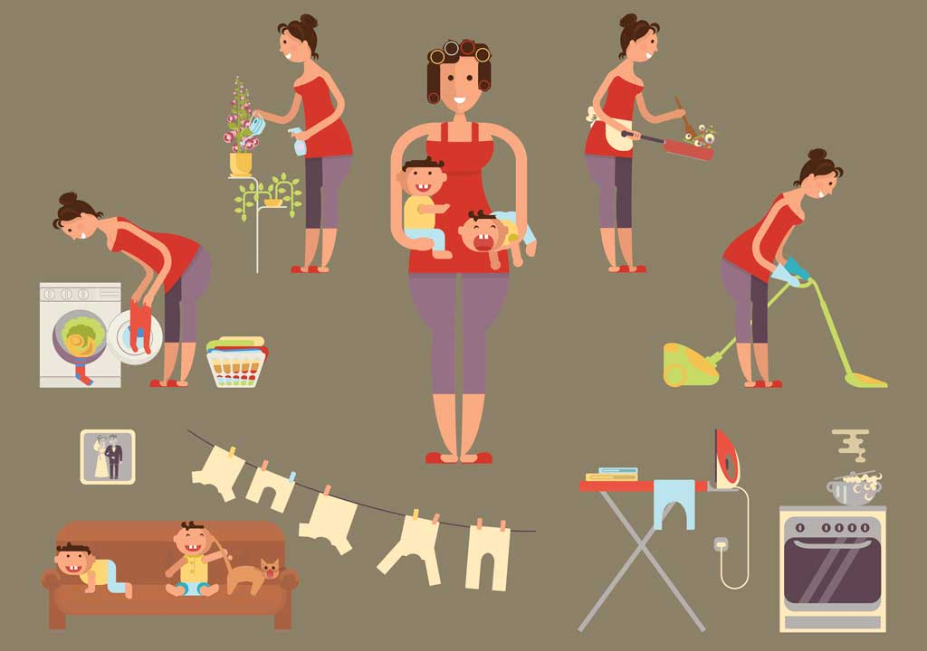
Theme 3: Pursuit & Choice
Women pursue the position of superintendent at a lower rate than men
Support system
Advice/mentorship
Family/gender roles
This Photo by Unknon Athor is licensed under C BY-NC-ND

Slide 8
Leadership in Higher Education:
Pursuit and Choice
(Gagliardi, et al., 2017)

Slide 9
Leadership in Higher Education:
Pursuit and Choice
(Gagliardi, et al., 2017)

Slide 10
Moving Forward
Review forthcoming report, The American College President: 2023 Edition.
What kinds of support are beneficial to women pursuing and serving in leadership positions?
How can organizations strategically recruit and retain effective female superintendents?
How can educational leadership develop stronger mentoring for aspiring female leaders?

Slide 11
Moving Forward
Ohio Association of Secondary School Principals
Women's Leadership Committee
OASSA Women's Conference
January 31, 2023-Feburary 1, 2023

Slide 12
Moving Forward
American Council on Education
Women’s Network Ohio
https://www.aceohiowomen.org/
‎@ACEWNO
Together We Can
24th Annual Conference
Columbus State Community College
November 4, 2022

Slide 13
References
Gagliardi, J. S., Espinosa, L. L., Turk, J.M., and Taylor, M. (2017). American college president study 2017. American Council on
Education.
Howard, E. & Gagliardi, J. (2018). Leading the way to parity: Preparation, persistence, and the role of women presidents. American
Council on Education.
Johnson, H. L. (2017). Pipelines, pathways, and institutional leadership: An Update on the status of women in higher education.
American Council on Education.
National Center for Education Statistics Integrated Postsecondary Education Data System. (2021). Digest of education statistics.
U.S. Department of Education.
Silbert, A., Punty, M., & Ghoniem, E. B. (2022).The women’s power gap at elite universities: Scaling the ivory tower. Women’s
Power Gap Study Series.

Slide 14
References cont'd
Bernal, C. A. (2019). Examining gender inequity in the superintendency: The gatekeeper perspective.
Bishop, T. (2021). Women superintendents' perspective on mentoring (Order No. 28718926). Available from ProQuest Dissertations
& Theses Global.
Characteristics of public school teachers. National Center for Educational Statistics. (n.d.). Retrieved March 1, 2022,
Davis, B. W., & Bowers, A. J. (2019). Examining the career pathways of educators with superintendent certification. Educational
Administration Quarterly, 55(1), 3–41.
Howard, E. R. (2016). Influence of mentorship experiences in the development of women superintendents in Texas as
transformational leaders
McDaniel, M. G. (2020). A Study of the Career Paths of Female Aspiring School Superintendents (dissertation).
O'Leary, J. D. O. L. D., & Ulas, E. (2010). Ohio ranks high in number of teachers with master's degrees. The Thomas B.
Fordham Institute.

Slide 15
Thank You & Contact Information
Dr. Rachel Althof
Rachel.althof@franklin.edu
Ed.D. Program Chair
Mrs. Katie Morgan
Morgak08@franklin.edu
Asst. Principal-Marysville Exempted Village Schools
Ed.D Student

