Slide 1
Training in Community Corrections
Tyler A. Sheppard

Slide 2
About
Probation Officer- Highland County
Correctional Officer-ODRC
Probation Officer for Specialized Dockets- Fairfield County

Slide 3
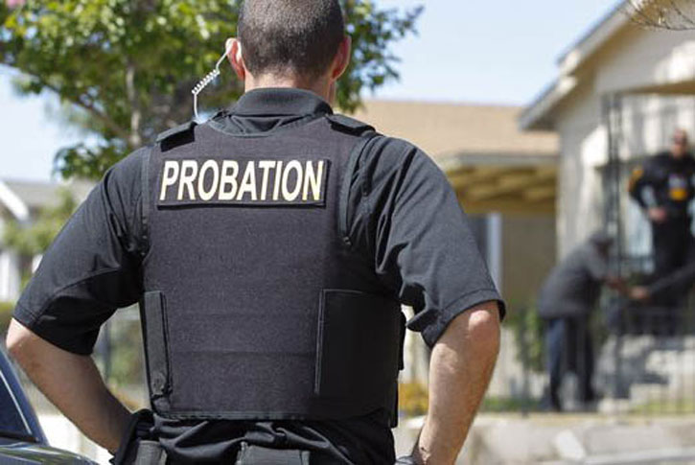
Overview
Introduction
What is a probation officer
Current Standards
Gaps
Recommendations

Slide 4
Probation in Ohio
Established in the Ohio Revised Code, 2301.27.
Provides Courts the authority to form departments, and establishes the powers of the probation officer.
Thousands in Ohio are currently on Probation.

Slide 5
My submission
Currently, in Ohio, there are no uniform hiring standards for a probation or parole officer.
Training and hiring standards are different. Unlike other Law Enforcement professionals, probation officers do not attend an academy or extensive training.

Slide 6
Mid County Ohio
Possess a degree from an accredited college or university with core course work in areas related to criminal justice, criminology, corrections, psychology, social work, or liberal arts.
Ohio Peace Officer Training Academy Certified, with one year’s experience.
Entry level salary: 43,000.

Slide 7
Small town Ohio
Must be (21) years of age at the time of appointment.
Conduct urine and alcohol testing to ensure compliance
Transport Offenders to jail. Candidates must be or be willing to become qualified to carry a handgun and maintain yearly qualifications.
35,000.00 ANNUALLY PLUS BENEFITS

Slide 8
Large city Ohio
Develop an appropriate supervision plan to address the requirements of the Court, and the assessed and identified needs of a defendant
A bachelor’s degree from an accredited college or university with core course work in areas related to criminal justice; and one year’s experience.
Entry level salary: 63,000.

Slide 9
Current Ohio Training
https://www.supremecourt.ohio.gov/Boards/judCollege/probationTraining/

Slide 10
What does this mean?
Departments implement different standards.
Departments see the role of probation officers differently.
Probation is often different from county to county.
Larger departments often pay for more adequate training.

Slide 11
How does Ohio Compare?
State of Maryland has implemented an Academy for all Community Corrections officers. https://dpscs.maryland.gov/publicinfo/publications/index.shtml
State of Oregon is seen as a nationwide leader for Community Corrections, and has a robust academy. https://www.oregon.gov/dpsst/CJ/Pages/BasicCert.aspx
Indiana has implemented pay and training standards for all probation officers. https://www.in.gov/courts/iocs/probation/

Slide 12
Solutions
Policy revisions can be made to existing law.
A training academy should be formed to adequately train all probation officers in the state.
Topics of interest: Firearms, ethics, and court policy.

Slide 13
Continued
Forming new departments?

Slide 14
Special Thanks

Slide 15
Closing
Probation remains the only law enforcement profession without an academy.
Probation remains one of the few professions with no uniform standards.
Uniform standards would positively impact community support and engagement.

Slide 16
Questions

