Slide 1
Measuring Patient Experience- Whose Voices are Heard?
Rachel Silsdorf, MMSL, CPXP, BCPA
Student-Doctorate of Healthcare Administration
Franklin University

Slide 2
What’s An HCAHPS and Where Did It Come From?
WHO
CMS
HCAHPS
The first national and standardized survey for patients in the United States to provide feedback on their experience of care.

Slide 3
HCAHPS
Results are publically available to help inform decision making for all healthcare consumers.
Represent 30% of bonuses and penalties paid to hospitals in the Value Based Purchasing (VBP) program.
Impact how hospitals are compensated for services and quality ratings.
Are linked to clinician payments and quality ratings

Slide 4
Known Challenges
In 2008 the response rate to surveys was 32.5%, in 2018 it dropped to 27% and has continued to drop each year since.
HCAHPS Online, 2022
Known Lack of Representation of English as Second Language Speakers
Figueroa, et al., 2018
Survey Does Not Ask About All the Issues that Patients Care About Most.
Raynard, et al., 2016

Slide 5
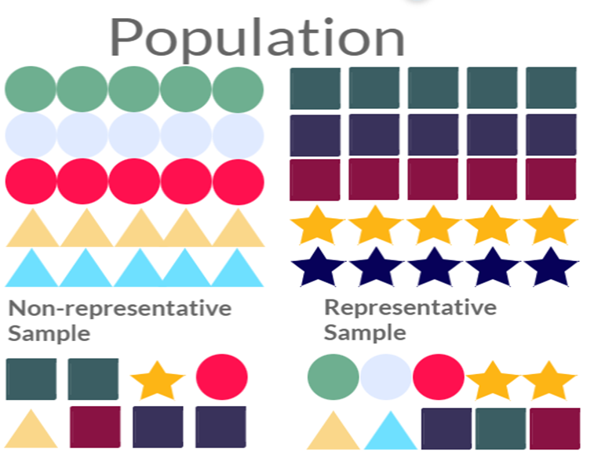
Research yet to come
Valid?
Validity, referring to the data as a reflection of the extent to which it measures the experience of patients in hospitals, and specifically what is important to those patients regarding their hospital experience.
Reliable?
Reliable referring to the extent to which the data set are responses submitted by respondents who accurately represent the U.S. hospital population.

Slide 6
References
Center for Medicare and Medicaid Services (26 January 2022). HCAHPS tables on HCAHPS online. https://hcahpsonline.org/en/summary-analyses/
Malpani, Rohil, Murillo Adrados, Michael R Mercier, Ryan P McLynn, Anoop R Galivanche, Neil Pathak, and Jonathan N Grauer. 2020. “Characteristics and Predictors of HCAHPS Nonresponse After Spine Surgery.” Spine 45 (8): E448–56. doi:10.1097/BRS.0000000000003287
Ranard, B. L., Werner, R. M., Antanavicius, T., Schwartz, H. A., Smith, R. J., Meisel, Z. F., Asch, D. A., Ungar, L. H., & Merchant, R. M. (2016). Yelp Reviews Of Hospital Care Can Supplement And Inform Traditional Surveys Of The Patient Experience Of Care. Health Affairs, 35(4), 697-705,1-6. http://dx.doi.org.links.franklin.edu/10.1377/hlthaff.2015.1030

